Slide 1
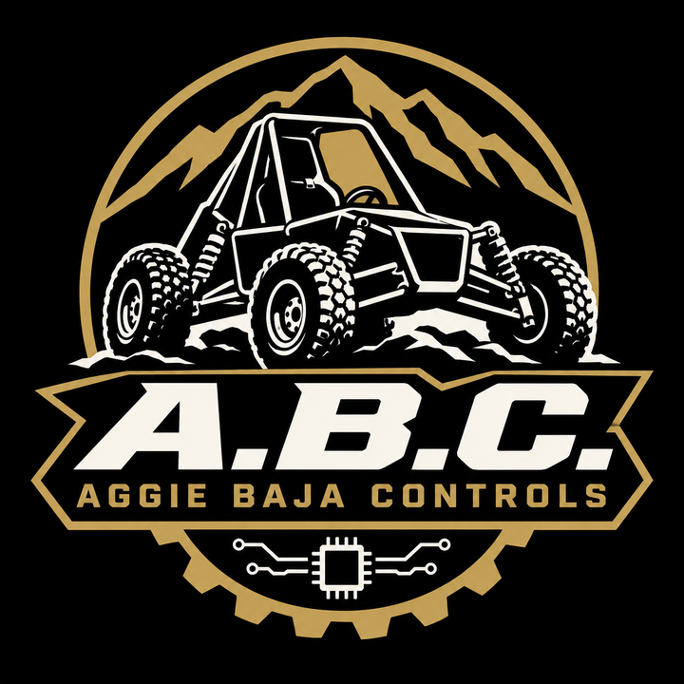
DRIVER-TO-PIT
COMMS
AGGIE BAJA CONTROLS
Why we’re going with Option A: MURS radios + the Rugged Radios driver kit
Alex · October 2026
Notes:
Short version: the research is done, we have an off-the-shelf, license-free solution, and this deck explains why Option A is the pick.

Slide 2
THE FOUR OPTIONS COMPARED
All off-the-shelf; A, B and C need no license.
A
B
C
D
MURS RADIO KIT
FRS RADIO KIT
BLUETOOTH MESH
LICENSED RACE KIT
Rugged driver kit + BTECH MURS-V2 radios
Same Rugged driver kit + BTECH FRS radios
Cardo Packtalk Outdoor helmet units
Rugged Driver & Crew Chief kit with R1 radios
Band: MURS, 151–154 MHz
License: none
Cost: ≈ $372
Band: FRS, 462–467 MHz
License: none
Cost: ≈ $322
Band: Bluetooth, 2.4 GHz
License: none
Cost: up to ≈ $495
Band: business band
License: FCC required
Cost: ≈ $850
Aggie Baja Controls · Driver-to-pit comms
02
Notes:
Quick overview of what we looked at. A and B share the same Rugged Radios driver kit (car harness, helmet kit, steering-wheel push-to-talk) and differ only in the radio. C is wireless helmet-to-helmet. D is a complete one-vendor race kit that needs a business-band license. Costs are core kits at October 2026 list prices.

Slide 3
OPTION A: MURS RADIOS
+ RUGGED DRIVER KIT
THE PICK
≈ $677
No license
2 W
complete, with a spare radio battery
MURS is license-free
with a cage-mounted antenna
Chosen from four off-the-shelf options, checked against the 2027 rules and our SOW.
Notes:
Option A is a real race setup: helmet kit, steering-wheel push-to-talk, car harness, on a license-free band. The MURS radio has a removable antenna, so the radio can sit protected inside the frame while the antenna goes up on the cage.

Slide 4
HOW OPTION A MEETS OUR REQUIREMENTS
Requirement | Target / threshold | Option A | Status
Radio range (SOW) | ≥ 750 m / ≥ 500 m | Est. 1.6–8 km (1–5 mi) | Verify: range walk
Cockpit egress (SOW) | ≤ 4 s / ≤ 5 s | Quick-release coil cord | Verify at install
Shock (SOW) | 15 g / 10 g | Not published by maker | Open: mount + shake test
Run time per event (VoC) | ≈ 20 hr | 18 hr battery + spare radio | Met with spare
No license (team pref.) | License-free | MURS, no FCC license | Met
2027 rules | Comply | Helmet padding; unplug to refuel | Met by design
Purchased cost (SOW goal) | ≤ $1,500 total | ≈ $677 complete | Met (about 45%)
Shock is the one real unknown for every option we looked at; no maker publishes a g rating.
Targets from our Statement of Work and Voice of the Customer · Rules: BSAE 2027 Rev A
04
Notes:
Range: BTECH doesn’t publish a range figure. Published estimates for 2 W MURS are 1–5 miles, toward the top end on flat, open ground; even the low end is about twice our 750 m target. We confirm with a range walk before testing. Shock: no maker publishes a g rating for these radios, so we plan an isolated mount and a shake test against the 10 g threshold. The VoC asks for about 20 hours per competition; one battery is rated up to 18, so the spare radio covers it. Rules covered: B.5.1 helmet, B.10.7 RF, D.8.3.7.2 refueling, Tech B.8.1 egress, B.10.1.1.7 battery mounting, B.13.6.2.4 RFID band.

Slide 5
WHY NOT THE OTHER THREE
B · ≈ $322
C · Up to ≈ $495
D · ≈ $850
FRS RADIO KIT
BLUETOOTH MESH
LICENSED RACE KIT
Same wiring as A, about $50 cheaper.
Hands-free, with no wiring in the car.
Cleanest kit, all from one vendor.
Fixed antenna: the radio itself has to sit high, exposed to mud and hits
22 shared channels get crowded at events
About 10 hr battery against our ~20 hr need
Built for motorcycles, not a CVT behind the helmet
Rated ~1 km between units: little margin over 750 m
Needs a business-band FCC license
About $130 more than a complete Option A
Aggie Baja Controls · Driver-to-pit comms
05
Notes:
B is the backup if budget gets tight: same Rugged driver kit with BTECH FRS radios. C is Cardo Packtalk Outdoor, the simplest install, but its rated talk time and motorcycle-oriented audio are weak spots for us. D is Rugged’s complete Driver & Crew Chief kit with R1 radios, which runs on business band and needs a license.

Slide 6




HOW OPTION A FITS TOGETHER
Plug-together parts; the only radio link is MURS between the two radios.
IN THE CAR
IN THE PIT
Helmet kit
Speakers + mic in the padding
Car harness
Rugged driver kit
Radio jumper
Kenwood 2-pin plug
Quick release cord
RULES COVERED
Helmet B.5.1 · Egress Tech B.8.1 · Refuel D.8.3.7.2 · Battery B.10.1.1.7
PTT button
Velcro on the wheel
BTECH MURS-V2
Inside the frame, secured
Crew headset
2-pin, with PTT
SMA coax
MURS link · 2 W
Est. 1.6–8 km
(1–5 mi)
Cage antenna
Clear of transponder and RFID tag
BTECH MURS-V2
Pit radio
06
Notes:
The Rugged driver kit ties the helmet kit, the steering-wheel push-to-talk button and the radio together. A quick-release coil cord lets the driver get out in under 5 seconds and unplug before refueling. The BTECH MURS-V2 bolts inside the frame; its SMA antenna port lets us put the antenna up on the cage, away from the transponder and RFID tag. The pit uses a second MURS-V2 with a 2-pin crew headset. We’ll confirm the 2-pin fit with Rugged before ordering. Range estimate: published figures for 2 W MURS radios are 1–5 miles (about 1.6–8 km), toward the top end on flat, open ground like the Arizona site. Even the low end is about twice the SOW’s 750 m target; we’ll confirm with a range walk.

Slide 7
HOW OPTION B FITS TOGETHER
Same wiring as A; the FRS radio’s antenna is fixed, so the radio has to sit up high.
IN THE CAR
IN THE PIT
Helmet kit
Speakers + mic in the padding
Car harness
Rugged driver kit
Radio jumper
Kenwood 2-pin plug
Quick release cord
FRS link · 2 W
Est. 2.4–4.8 km
(1.5–3 mi)
RULES COVERED
Helmet B.5.1 · Egress Tech B.8.1 · Refuel D.8.3.7.2 · Battery B.10.1.1.7
PTT button
Velcro on the wheel
BTECH FRS radio
Mounted high, clear view
BTECH FRS radio
Pit radio
Crew headset
2-pin, with PTT
07
Notes:
Option B uses the same Rugged driver kit as A: helmet kit, car harness, steering-wheel PTT and radio jumper, with the same quick-release coil cord for egress and refueling. The difference is the radio. FRS radios have a fixed antenna by law, so there’s no cage antenna; the radio itself has to be mounted high with a clear view, which leaves it more exposed to mud and hits. Range estimate: Cobra lists 1.5 to 3+ miles for 2 W handhelds on flat, unobstructed ground. FRS has 22 shared channels, which get crowded at events. BTECH’s listing doesn’t clearly state the FRS radio’s jack type, so the 2-pin fit would need confirming.

Slide 8
HOW OPTION C FITS TOGETHER
Wireless helmet units; nothing is wired into the car.
ON THE DRIVER
IN THE PIT
Built-in battery
About 10 hr talk time
Bluetooth mesh
Rated ~1 km
(0.6 mi) per hop
RULES COVERED
Helmet B.5.1 · No cord to unplug at egress or refuel
Speakers + mic
Mounted in the helmet
Cardo Packtalk
Clamped to the helmet
Cardo Packtalk
Pit crew unit
Extra units
Optional relays
08
Notes:
Option C is Cardo’s Packtalk Outdoor: a unit clamps to each helmet, with its own speakers and mic, and talks hands-free over a Bluetooth mesh. Nothing is wired into the car, so there’s no cord to unplug for egress or refueling. The maker rates about 1 km between two units and up to about 5 km across a group of up to 15, so crew with extra units at far turns can relay. The weak spots for us: about 10 hours of talk time against our roughly 20-hour need, audio designed for motorcycles rather than a CVT right behind the helmet, and only a small margin over our 750 m range target.

Slide 9
HOW OPTION D FITS TOGETHER
One-vendor kit; the R1 radios run on business band and need an FCC license.
IN THE CAR
IN THE PIT
Helmet kit
Included in the kit
Car harness
Included in the kit
Radio jumper
Included in the kit
Quick release cord
Business band · 5 W
FCC license needed
Range not published
RULES COVERED
Helmet B.5.1 · Egress Tech B.8.1 · Refuel D.8.3.7.2 · Battery B.10.1.1.7
PTT button
Included in the kit
Rugged R1 radio
In the kit’s aluminum box
Rugged R1 radio
On the crew radio belt
H42 crew headset
Coil cord, with PTT
09
Notes:
Option D is Rugged Radios’ Offroad Driver & Crew Chief kit: two R1 handheld radios, the wired car harness with helmet kit, radio jumper, steering-wheel PTT, an aluminum radio box for the car, and an H42 crew headset with radio belt and coil cord for the pit. Everything comes from one vendor, so fit isn’t a question. The R1 is a 5 W dual-band business-band radio, which needs an FCC business license, and Rugged doesn’t publish a range figure. That license requirement, plus the higher cost, is why we didn’t pick it.

Slide 10
WHAT IT COSTS
Item | Qty | Unit | Total
Rugged Offroad Driver Kit (SS-KIT) | 1 | $282.00 | $282.00
BTECH MURS-V2 radio | 2 | $44.89 | $89.78
BTECH BL-8 USB-C 1800mAh Li-ion Replacement Battery (covers 20 hr) | 1 | $16.49 | $16.49
Rugged H42 crew headset (pit) | 1 | $159.00 | $159.00
Rugged CC-KEN 2-pin headset cord | 1 | $29.95 | $29.95
DPD MURS antenna, SMA, 17 ft coax | 1 | $99.95 | $99.95
Total |  |  | $677.17
$677.17
About 45% of our $1,500 controls goal
Complete kit, including a spare radio battery
List prices, October 2026; item names link to each product. Voice radio gear can be left out of the cost report (B.10.7.1).
Aggie Baja Controls · Driver-to-pit comms
10
Notes:
The $1,500 is the SOW goal for purchased parts across all five control systems, so comms at about $417 leaves most of the budget for steering, throttle, brakes and 4WD. The spare radio doubles as a second battery to cover the roughly 20 hours of use the VoC asks for. The pit headset is Rugged’s H42 with PTT; it needs the CC-KEN cord to plug into a 2-pin radio. The DPD antenna is tuned for MURS and comes with 17 ft of coax and an SMA plug; it’s 46 in. tall and ships on a magnet mount, so we’d bolt its NMO base to a bracket on the cage instead.

Slide 11
NEXT STEPS
Lined up with our Gantt chart; every check before testing happens in the shop.
Dec 7–13, 2026
Jan 2027
Feb 2027
By Mar 15, 2027
Mar 29, 2027
Apr 29, 2027
ORDER
BENCH CHECK
INSTALL
VERIFY
TESTING PHASE
RACE DAY
With the rest of the controls parts, after confirming the 2-pin fit.
Plugs fit, audio is clear, PTT keys the radio.
Mount radio, antenna and cord; time the egress.
Range walk, full-throttle noise test, shake test.
Drivers practice pit calls during test runs.
Baja SAE Arizona.
Aggie Baja Controls · Driver-to-pit comms
11
Notes:
Dates come from our Gantt chart and SOW: order in the Dec 7–13 “finalize design, order parts” week, well ahead of the Feb 1 part-selection and Mar 1 off-the-shelf deadlines. The SOW targets March 15 for assemblies ready for integrated testing (threshold March 31), and the testing phase starts March 29.

Slide 12
RESEARCH BEHIND THIS
Baja SAE Rules 2027 Rev A and BSAE 2026 Tech Sheet Rev C
Aggie Baja Controls Statement of Work, Voice of the Customer and Gantt chart
Rugged Radios: Offroad Driver Communication Kit (SS-KIT)
Rugged Radios: Offroad Driver & Crew Chief Racing Kit
BTECH: MURS-V2 license-free radio
BTECH: FRS radios
UTV Source: Cardo Packtalk Outdoor
Midland: Cornell Baja team helmet headsets
Rugged Radios: H42 headset · CC-KEN cord
DPD Productions: MURS 5/8-wave mobile antenna
MURS range: OneSDR · Miklor
24 Hours of Lemons forum: race radio setups
Aggie Baja Controls · Driver-to-pit comms
12

